Slide 1
Version Control
Part 1: Editing and Publishing Files
Computer Science and Software Engineering
© 2014 Project Lead The Way, Inc.

Slide 2
Why Version Control?
Keep track of previous versions – who did what and when? Can we go back?
Merge teammates’ contributions.

Slide 3
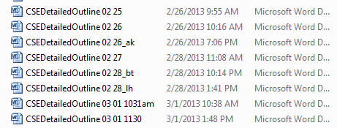
Do-It-Yourself Version Control
Dates and initials in filenames
Tells (hopefully) “When?” and “Who?”
Commits to the old file once you switch to a new filename
.

Slide 4

Do-It-Yourself Version Control
Track changes
Tells “What?”
None of this helps you merge branches of development!
.

Slide 5
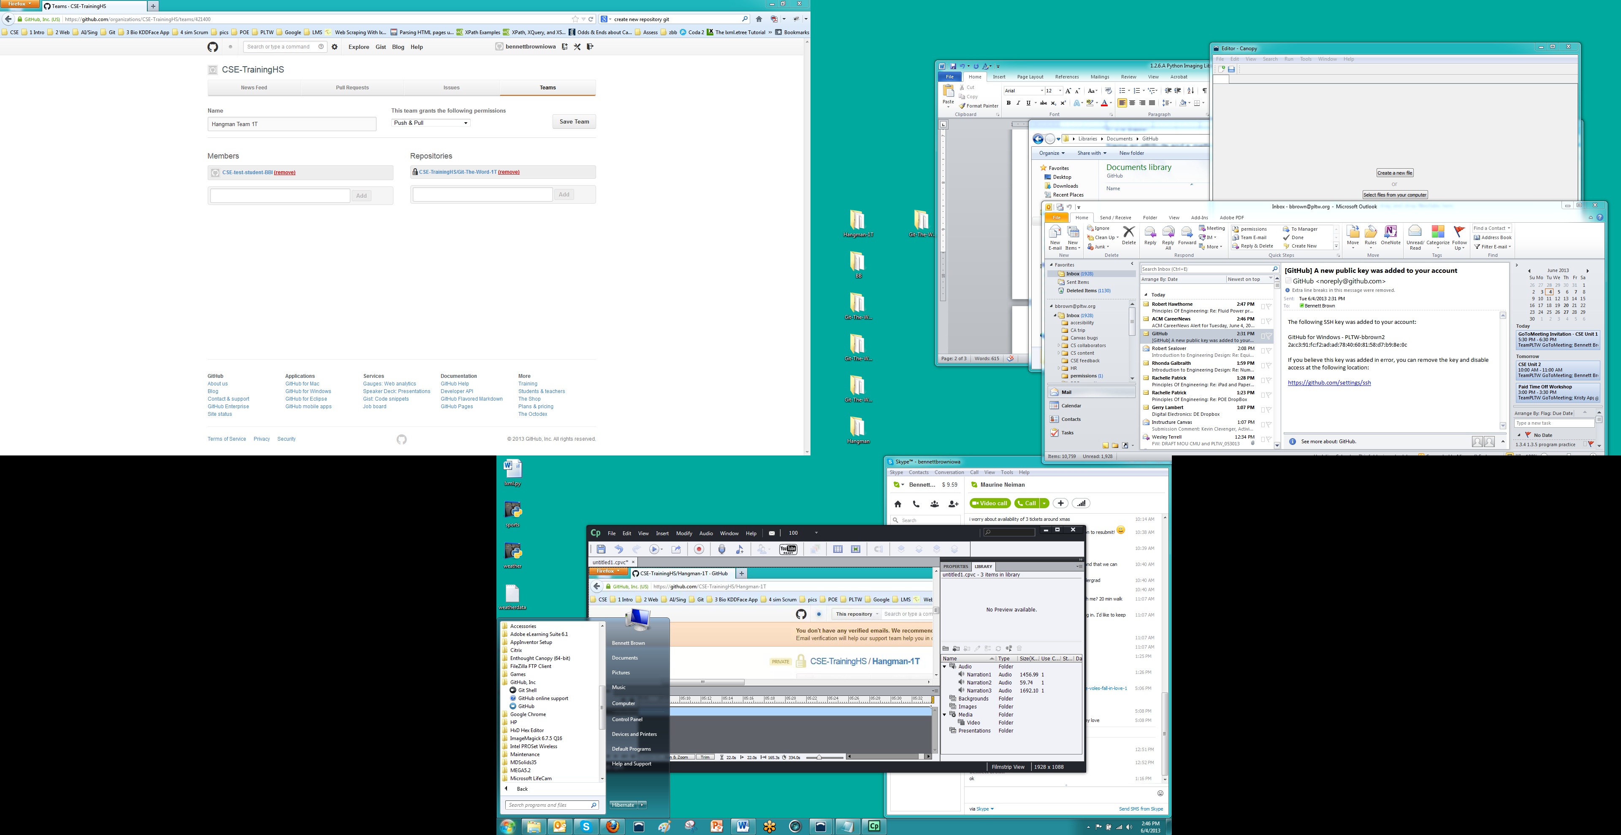
GitHub
Collaboration using the cloud
Repositories of files
GitHub-for-Windows:
Clone (copy to local machine)
Commit (snapshot)
Push (move to another repository)
GitHub in Browser
To discuss commits
Great for merging differences
.

Slide 6
Summary: Version Control
A
remote origin
files
A
local clone
files
Notes:
A repository in the cloud had one commit, ‘A’. This commit includes information about a directory tree of files that it refers to. A repository can include many commits, each with their own versions of files. The commits can be in a series, one after another, or in a branched structure, and the repository will include information about all committed versions of the files. The repository we started with had only one commit.
We cloned this repository to our local machine. A “remote” relationship between the two repositories was established to allow us to synchronize them easily.

Slide 7
Summary: Version Control
A
B
C
origin
files
files
files
head
head
A
B
C
clone
files
files
files
files
Notes:
We made changes to the files on our local machine, but the repository did not change.
We committed those changes as commit ‘B’, and our local repository had all data about both commits. We could now make additional changes starting from the versions recorded in either commit. The blue arrow goes backward in time, showing that commit ‘B’ refers to commit ‘A’.
We made additional changes from the “head” of our local development, which was commit ‘B’, and then committed them as commit ‘C’.
We synchronized with the remote repository by pushing our commits to the “origin”.
Now both repositories contain all three commits, and a collaborator could start their work with any of the three sets of versions of our files.

Slide 8
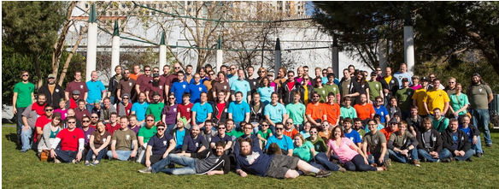

Summary: Version Control
E
Xena- origin
A
B
C
D
F
Laura- clone
Josh- clone
A
B
C
D
A
B
C
E
F
D
Notes:
The real power of GitHub is that it allows developers to collaborate by merging their work together without losing track of who built off of what. GitHub makes it easy for people to incorporate the improvements made by others. The following information is beyond our scope right now, so feel free to ignore it. But maybe seeing it now will help you understand the power of GitHub.
Xena has shared her repository on GitHub, with commits ‘A’, ‘B’, and ‘C’.
Laura clones it. Laura adds a new feature and makes a local commit ‘D’.
Josh also clones Xena’s repository and improves it, making a local commit ‘E’.
Laura asks Xena to incorporate her feature by making a “pull request”. Xena pulls Laura’s code into the cloud repository.
Josh synchronizes his clone with the origin repo and discovers that his commit ‘E’ is a branch from a commit earlier than the current head of the origin. Josh sees the individual line differences among the versions. He creates a new version built from both commits ‘D’ and ‘E’, and commits the merged work as ‘F’. He requests that Xena pull his commits ‘E’ and ‘F’ into her repository, and she does.
GitHub does the work for the group, keeping track of which version incorporate all the revisions of which other versions. Thanks to this GitHub team, lots of developers can combine their work while creating lots of simultaneous versions without getting lost.

